Slide 1
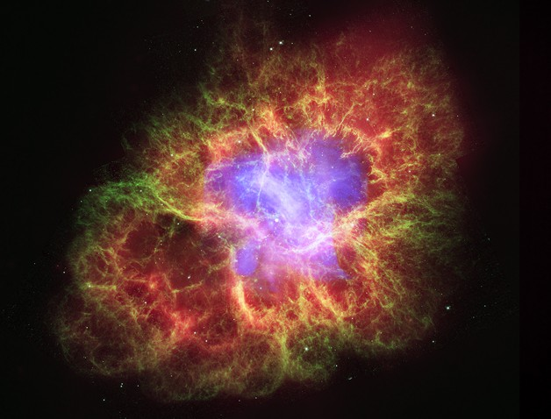
Light, Matter, and Telescopes
Crab Nebula supernova remnant;
composite image from three space telescopes:
Chandra/X-ray
Hubble/visible
Spitzer/IR

Slide 2
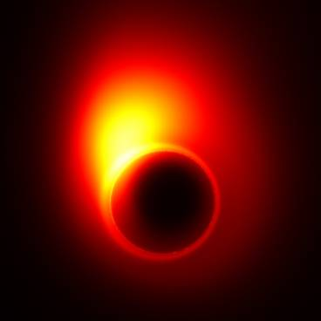
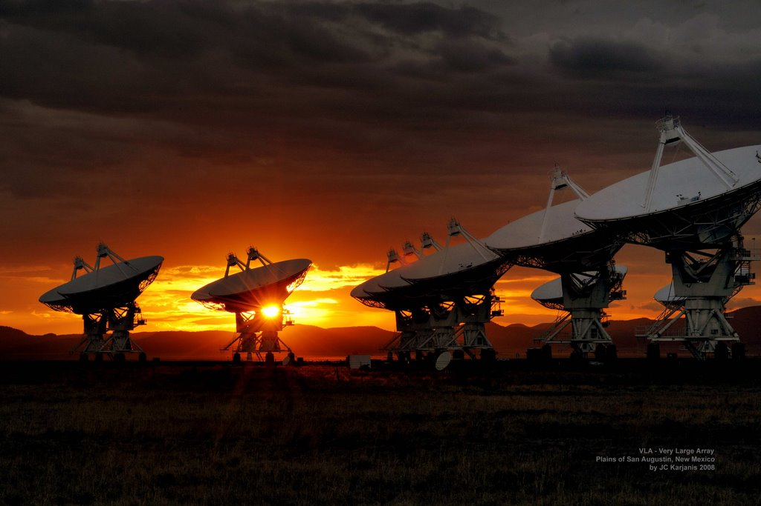
Light, Matter, and Telescopes
Event Horizon Telescope will use arrays of radio telescopes to synthesize ultra-high resolution images of black hole Sgr A*

Slide 3
Light, Matter, and Telescopes
Light
Electric & magnetic fields
Electromagnetic waves & electromagnetic spectrum
Matter
Interaction between electromagnetism and matter
Electromagnetic sources & spectra: thermal, atomic/ molecular emission/absorption line spectra, synchrotron
Doppler effect: Measuring speed and rotation of objects
Telescopes
Light collecting area and angular resolution
Refraction vs. reflecting telescopes
Imaging, spectroscopy, and time monitoring
Atmospheric effects, adaptive optics, space telescopes
Interferometry

Slide 4
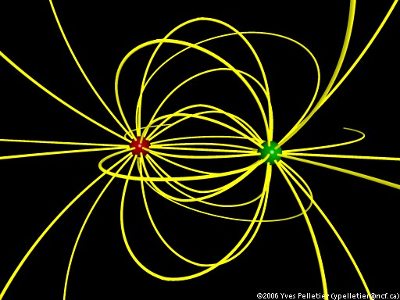
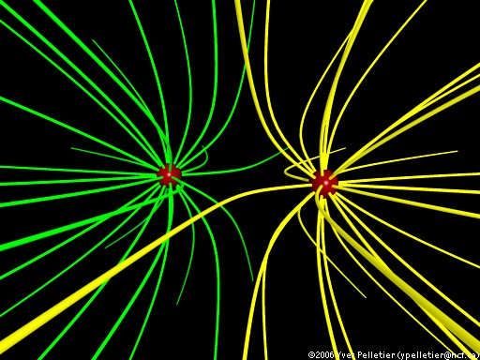
Electric Field
Space around electric charges is filled with a electric field; its strength and direction are indicated by electric field lines
two opposite charges
two like charges

Slide 5
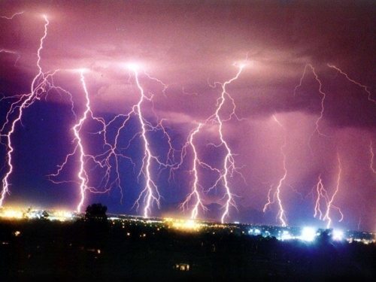
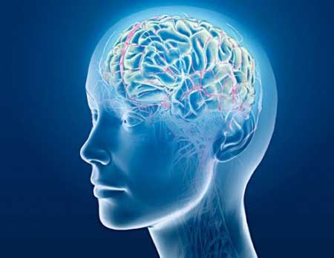
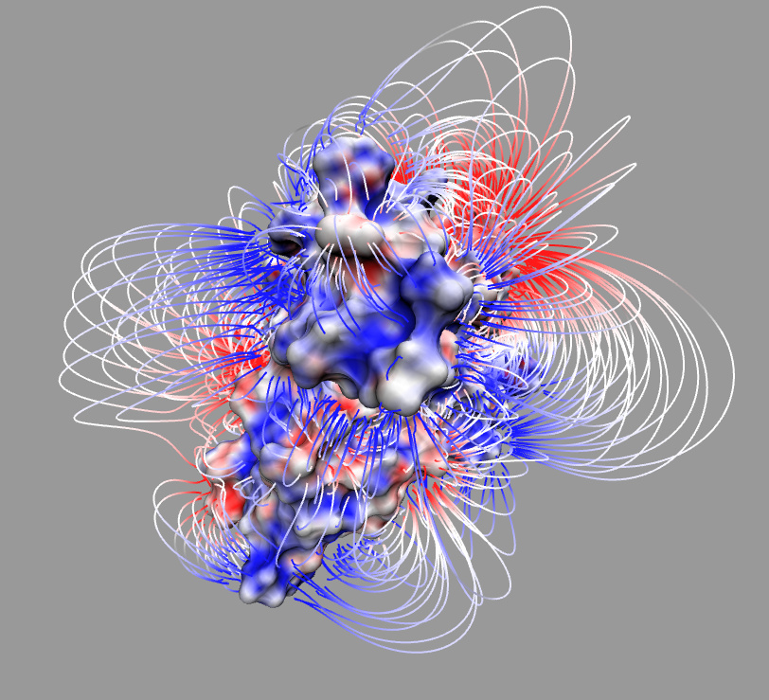
Electric Fields in Nature

Slide 6
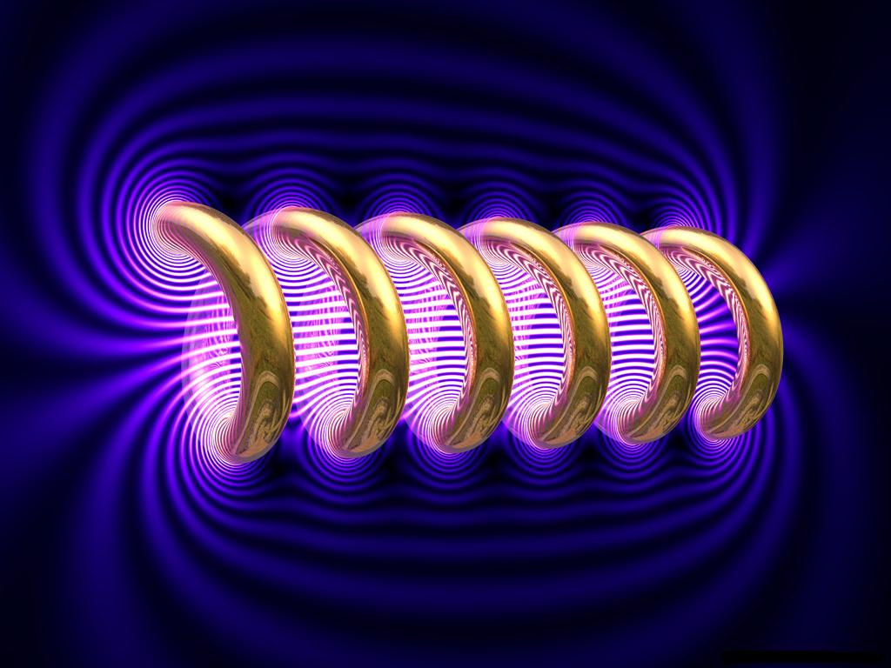
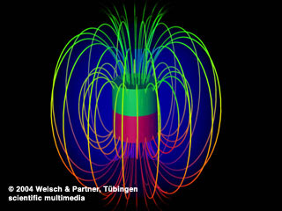
Magnetic Field
Space around electric currents is filled with a magnetic field; its strength and direction are indicated by magnetic field lines
electric current in a coil of wire
atomic “electric currents” (electron spin) in a bar magnet

Slide 7
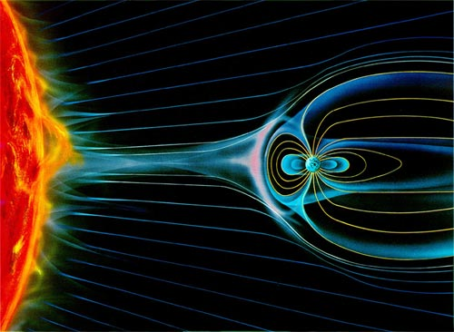
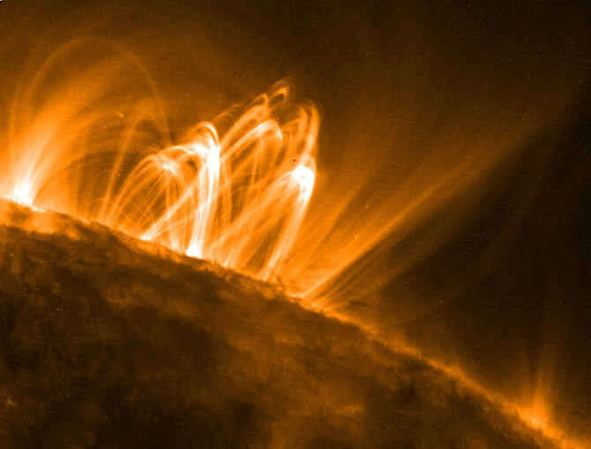
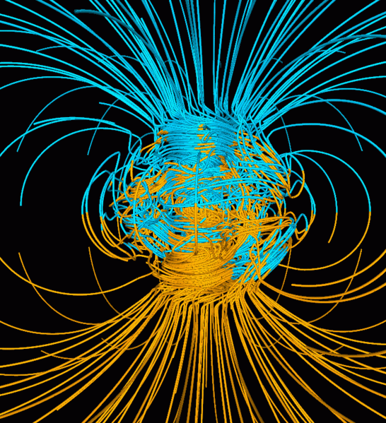
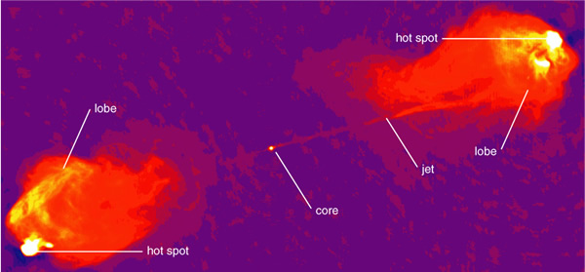
Magnetic Fields in Nature

Slide 8
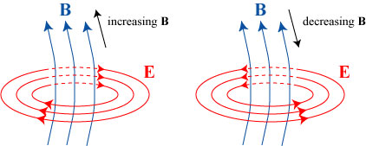
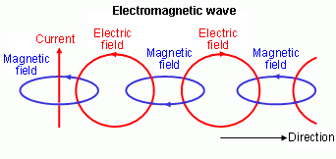
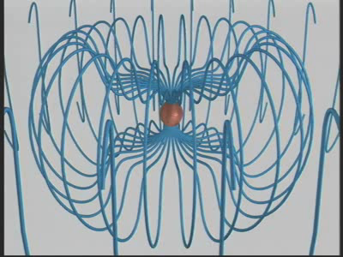
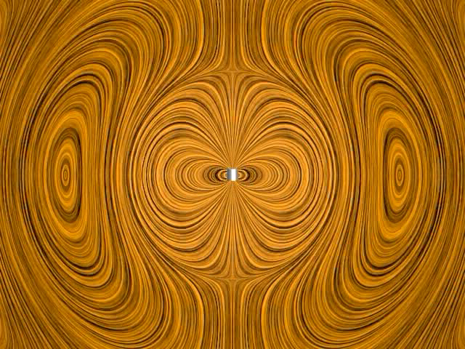
Electromagnet Waves
A changing magnetic field creates an electric field…
…and vice versa, generating an electromagnetic wave

Slide 9
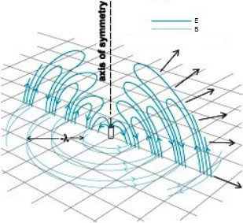
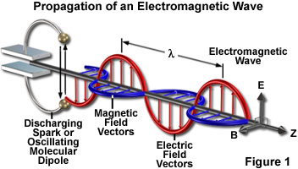
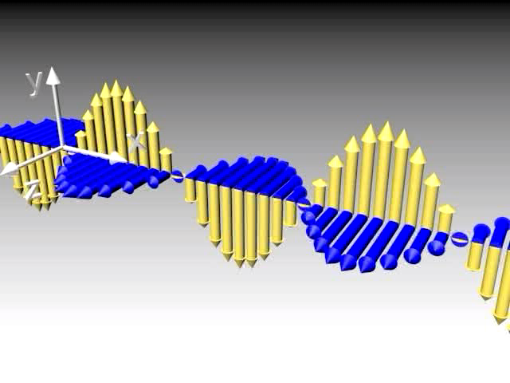
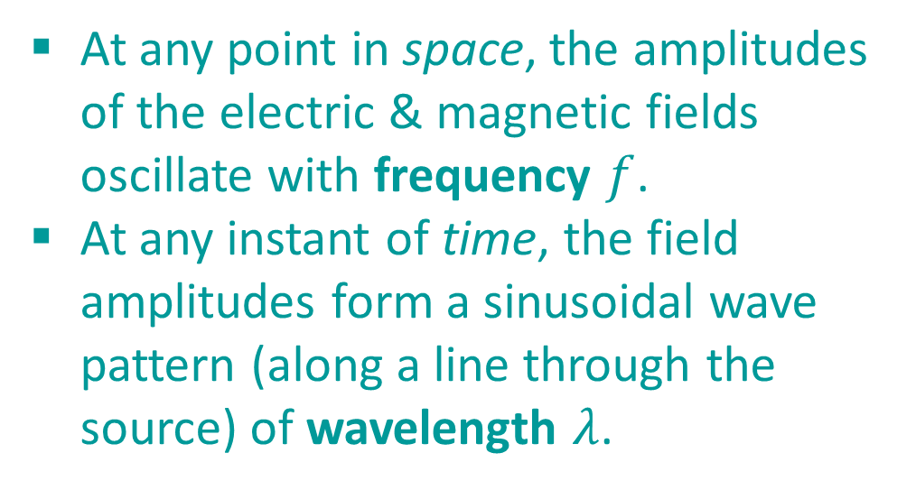
Electromagnet Waves
At any point in space, the amplitudes of the electric & magnetic fields oscillate with frequency $f$.
At any instant of time, the field amplitudes form a sinusoidal wave pattern (along a line through the source) of wavelength $λ$.

Slide 10
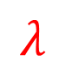
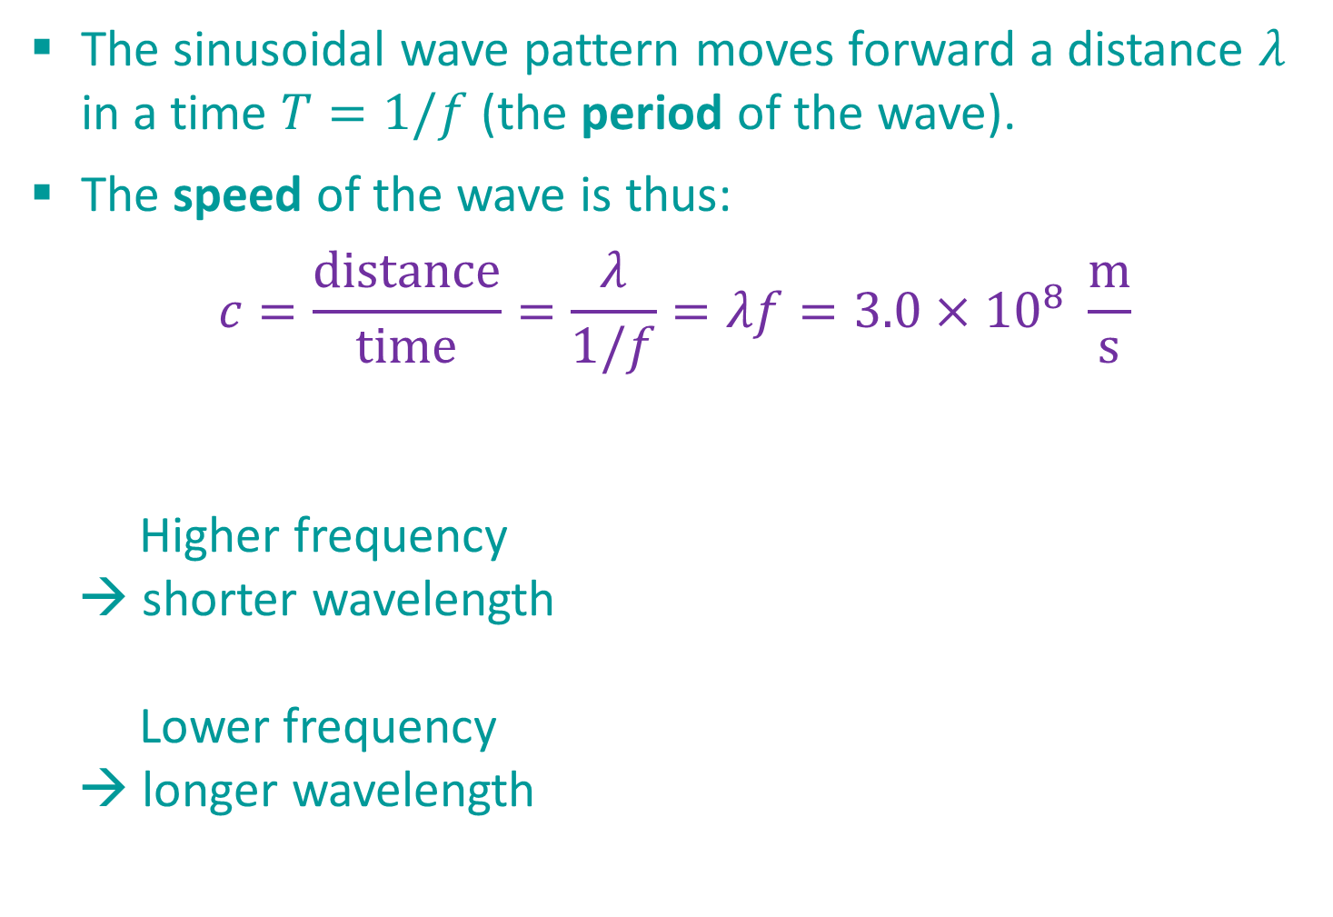
Electromagnet Waves
The sinusoidal wave pattern moves forward a distance $λ$ in a time $T=1/f$ (the period of the wave).
The speed of the wave is thus:
$$c=\frac{distance}{time}=\frac{λ}{1/f}=λf=3.0×{10}^{8} \frac{m}{s}$$
Higher frequency
→ shorter wavelength
Lower frequency
→ longer wavelength
$$λ$$

Slide 11
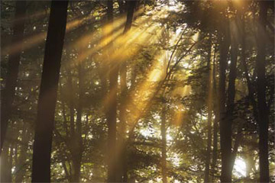
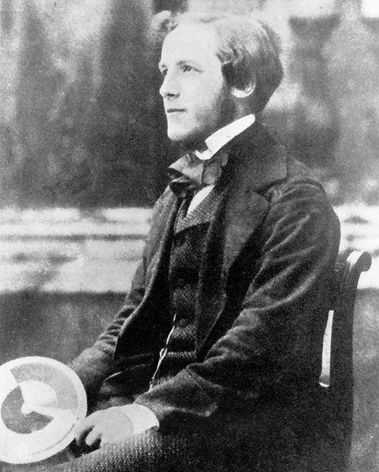
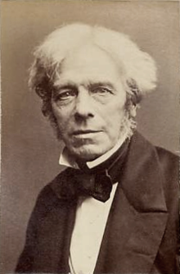
Light is an Electromagnetic Wave

Slide 12
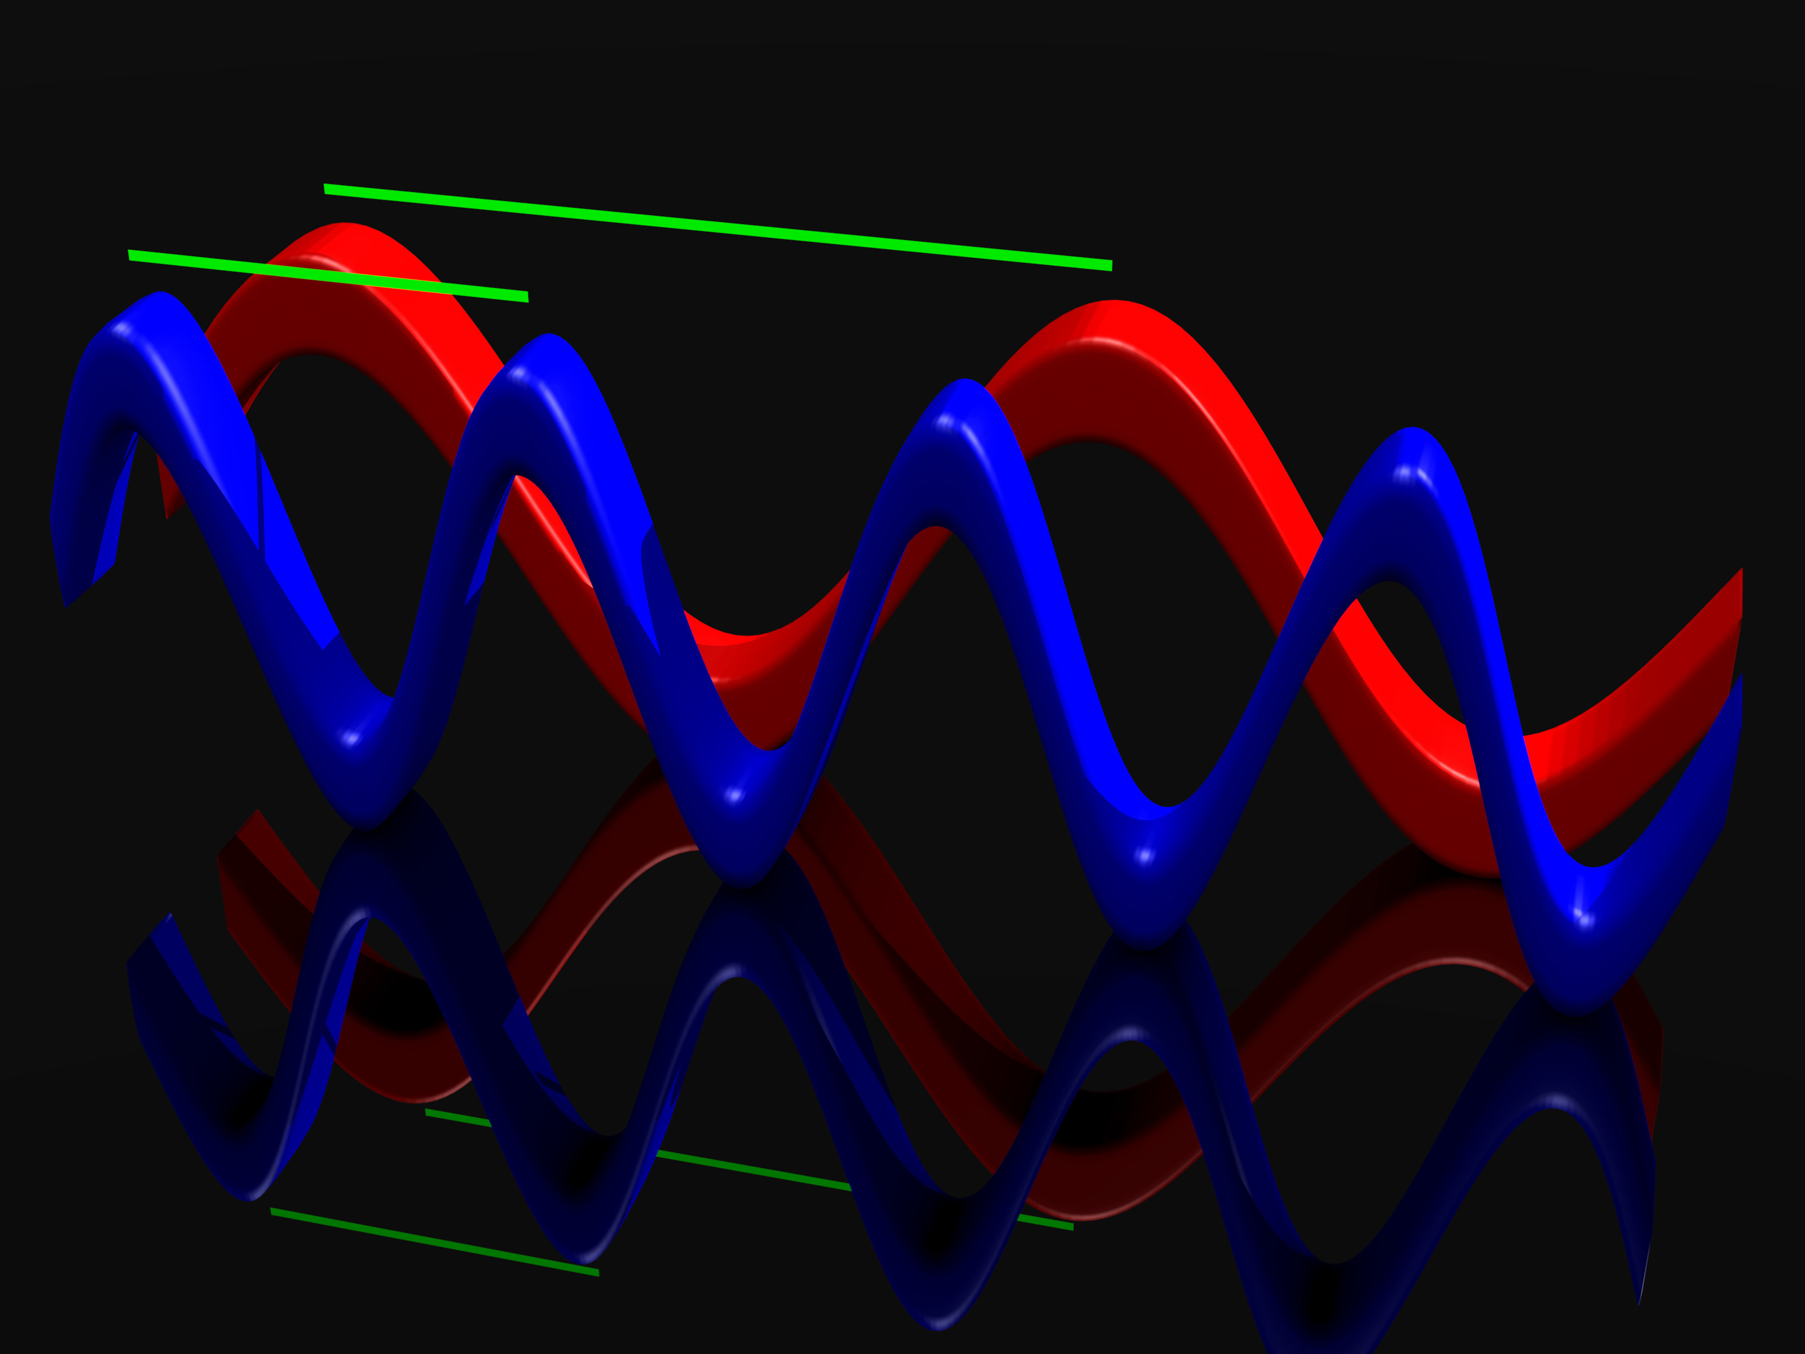
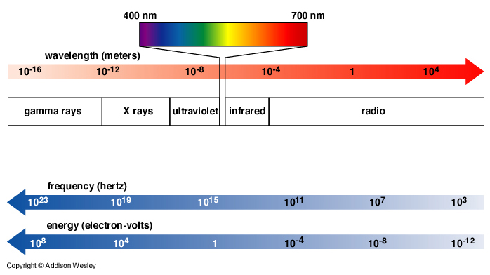
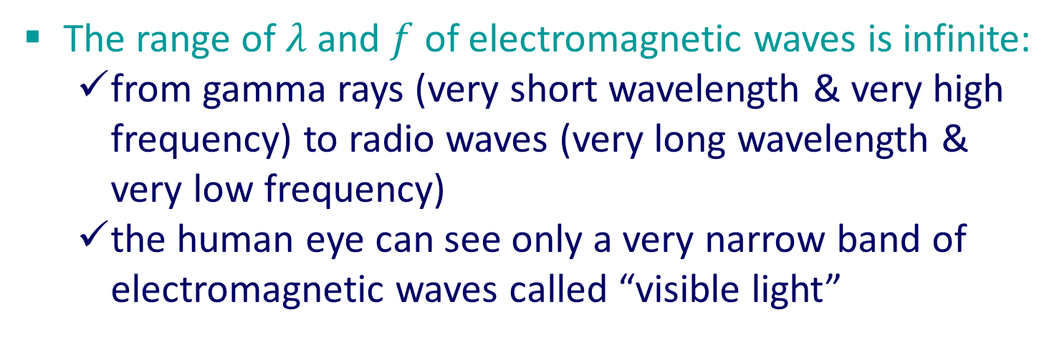
Electromagnetic Spectrum
The range of $λ$and $f$ of electromagnetic waves is infinite:
from gamma rays (very short wavelength & very high frequency) to radio waves (very long wavelength & very low frequency)
the human eye can see only a very narrow band of electromagnetic waves called “visible light”

Slide 13
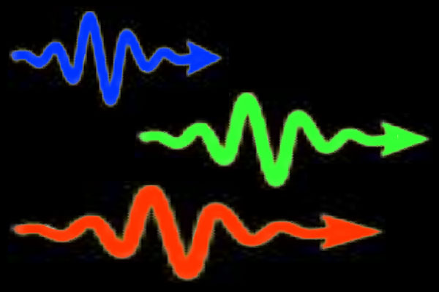
Quantum Nature of Electromagnetic Fields
The quantum nature of our universe demands that electro-magnetic waves (technically, electromagnetic radiation) is really a shower of “quantum particles” called photons, which have both wave-like & particle-like properties.
→

Slide 14
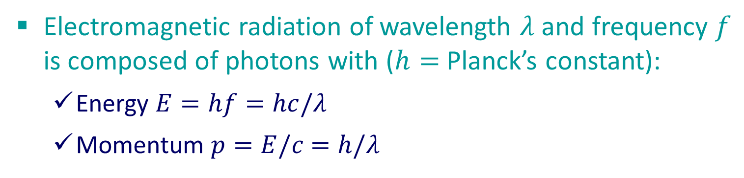
Quantum Nature of Electromagnetic Fields
Electromagnetic radiation of wavelength $λ$and frequency $f$ is composed of photons with ($h=$ Planck’s constant):
Energy $E=hf=hc/λ$
Momentum $p=E/c$ $=h/λ$
→

Slide 15
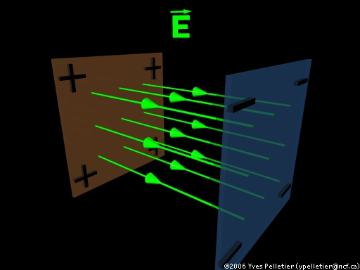
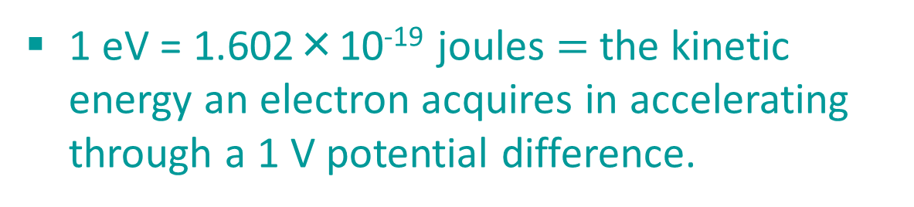
Electromagnetic Spectrum—Revisited
Photons have wavelength, frequency, and energy
1 eV = 1.602×10⁻¹⁹ joules $=$ the kinetic energy an electron acquires in accelerating through a 1 V potential difference.

Slide 16
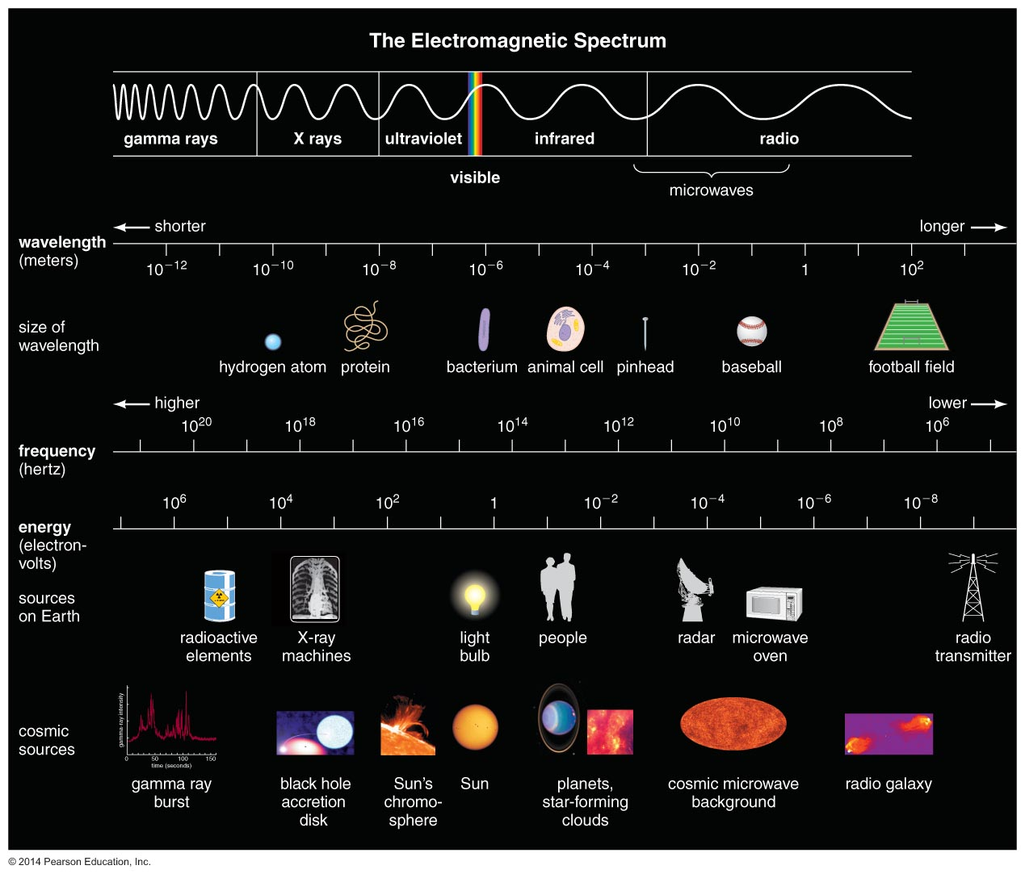

Electromagnetic Spectrum
Range of $λ$ and $E$ allows us to “probe” the same range of physical scales: size $\sim λ$ and energy $\sim E$.

Slide 17
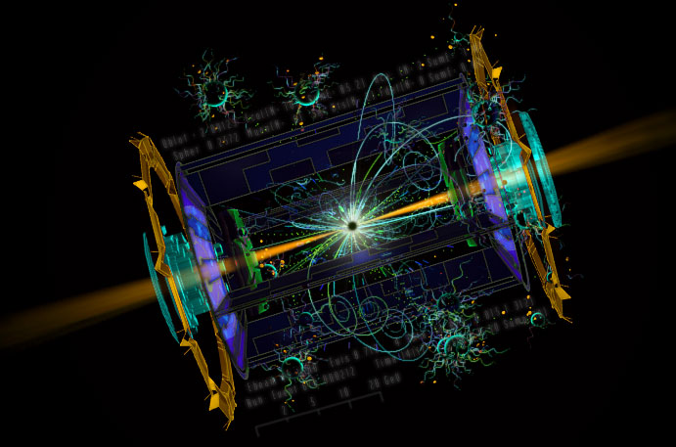
Action of Electromagnetic Fields on Matter
Electric & magnetic fields exert forces on charged particles, causing them to accelerate.
Electric fields can change the speed of motion, and so the energy of charged particles (e.g. particle accelerator)

Slide 18
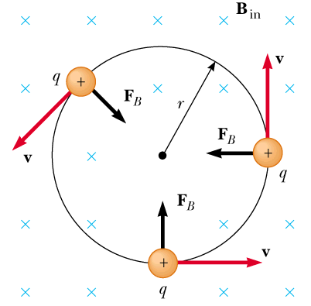
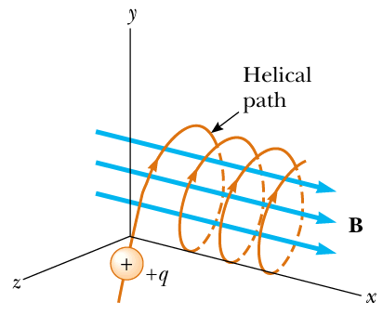
Action of Electromagnetic Fields on Matter
Electric & magnetic fields exert forces on charged particles, causing them to accelerate.
Magnetic fields change the direction of motion, but not the speed (or energy) of charged particles.

Slide 19
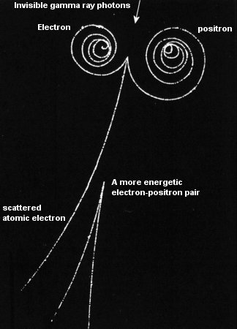
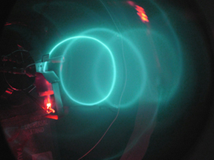
Action of Electromagnetic Fields on Matter
Electric & magnetic fields exert forces on charged particles, causing them to accelerate.
Magnetic fields change the direction of motion, but not the speed (or energy) of charged particles.

Slide 20
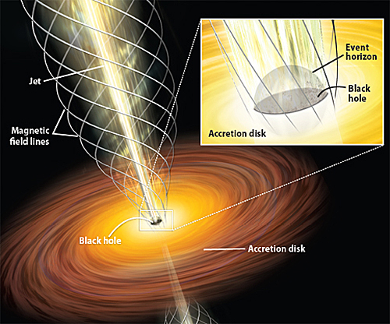
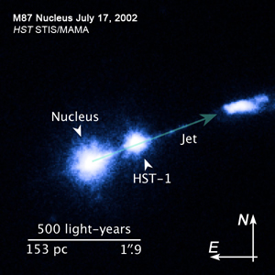
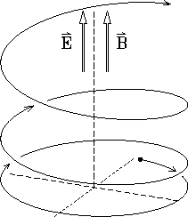
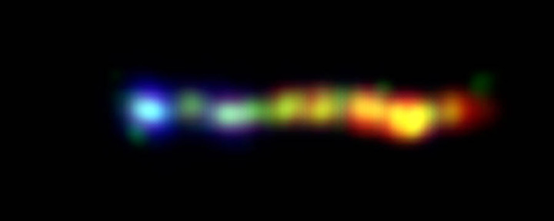
Action of Electromagnetic Fields on Matter
Electric & magnetic fields exert forces on charged particles, causing them to accelerate.
Electric and magnetic fields are often present together

Slide 21
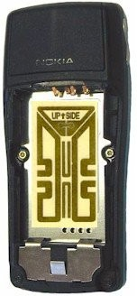
Action of Matter on Electromagnetic Fields
Conversely, the source of all electromagnetic radiation is accelerated electric charge.
E.g.: The electronic circuit in the cell phone forces electrons in the antenna to accelerate back and forth, emitting radio waves.

Slide 22
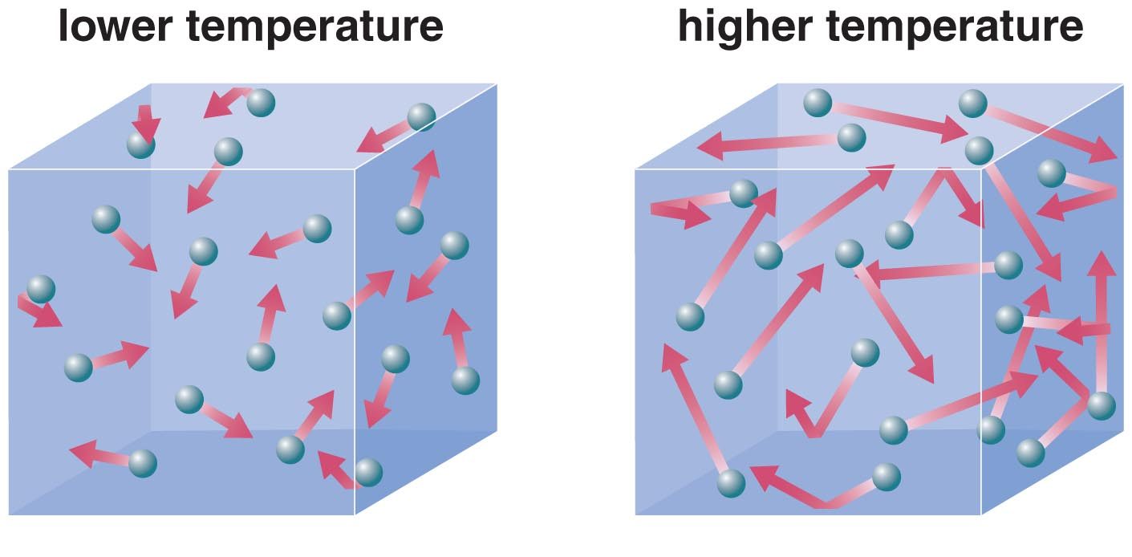
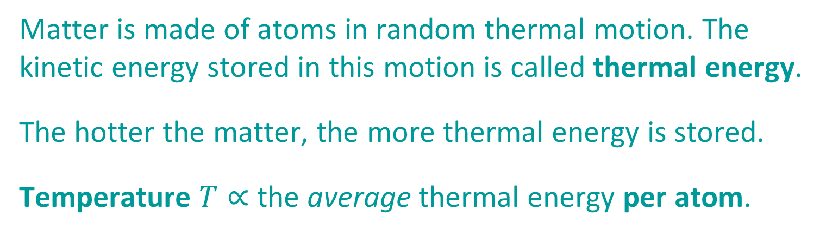
Types of EM Sources: Thermal Radiation
Matter is made of atoms in random thermal motion. The kinetic energy stored in this motion is called thermal energy.
The hotter the matter, the more thermal energy is stored.
Temperature $T∝$ the average thermal energy per atom.

Slide 23
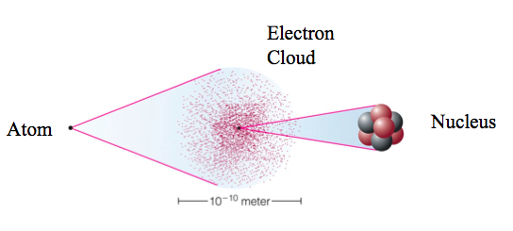
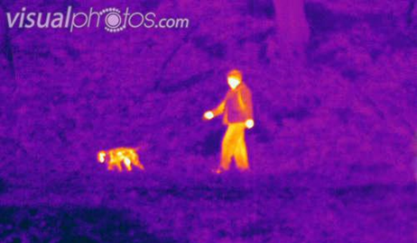
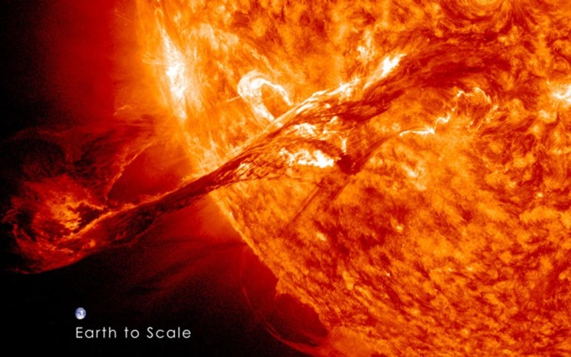
Types of EM Sources: Thermal Radiation
Atoms, in turn, are made of charged particles.
When atoms collide the charged particles “jiggle around” (accelerate), emitting a type of random electromagnetic radiation called thermal radiation.

Slide 24

Types of EM Sources: Thermal Radiation
An object's thermal radiation spectrum depends on only one property: its temperature.

Slide 25

Types of EM Sources: Thermal Radiation
A hotter object is brightest at a shorter wavelength (or higher frequency, or higher energy):
$$λ_{max}\left(nm\right)=\frac{2,900,000}{T\left(K\right)} (Wien^{′}s Law)$$

Slide 26

Types of EM Sources: Thermal Radiation
A hotter object emits more thermal power (energy per second per square meter, added up over all wavelengths):
$$F(W/m2)=σT^{4} (Stefan−Boltzmann Law)$$
$$σ=5.67×{10}^{−8} W/(m2K4)$$

Slide 27

Example 1:
Consider four sources with temperatures: 50000K, 5000K, 500K, 50K.
What is the wavelength at which each is the brightest?
$$λ_{max}\left(nm\right)=\frac{2,900,000}{T\left(K\right)}$$

Slide 28

Example 1:
Consider four sources with temperatures: 50000K, 5000K, 500K, 50K.
What is the wavelength at which each is the brightest?
$$λ_{max}\left(nm\right)=\frac{2,900,000}{T\left(K\right)}$$
From Wien’s Law: $λ_{max}=58$ nm (UV), $580$ nm (visible), $5800$ nm $=5.8$ μm (IR), $0.058$ mm (mm).

Slide 29



Example 1:
Different types of objects in space are brightest at different wavelengths. Telescopes and detectors are designed to operate in different wavelength ranges.
Viewing the same object in different wavelength ranges reveals new information.

Slide 30

Example 2:
Two stars have the same temperature, but one is observed to emit energy at $10,000$times the rate of the other. How can we explain this difference?
$$F(W/m2)=σT^{4} (Stefan−Boltzmann Law)$$

Slide 31

Example 2:
Two stars have the same temperature, but one is observed to emit energy at $10,000$times the rate of the other. How can we explain this difference?
$$F(W/m2)=σT^{4} (Stefan−Boltzmann Law)$$
$F=$ energy/second/area $= σT^{4}$, so the difference must be in the total surface area ($A=4πR^{2}$) of the two stars.
Energy/second $=$ area x (energy/second/area) $=4πR^{2}σT^{4}$
$$10,000=\frac{4π{R_{A}^{}}^{2}σT^{4}}{4π{R_{B}^{}}^{2}σT^{4}}⇒\frac{R_{A}^{}}{R_{B}^{}}=\sqrt{10,000}=100$$
$∴$ the more luminous star has a radius 100 times larger

Slide 32


Example 2:
Stars come in a huge range of sizes (and temperatures)

Slide 33
Example 3:
Two stars are found to have the same temperature & size, but one appears 10,000 times brighter than the other. How can we explain this difference?

Slide 34


Example 3:
Two stars are found to have the same temperature & size, but one appears 10,000 times brighter than the other. How can we explain this difference?
Apparent brightness depends on absolute brightness and distance. Absolute brightness is called luminosity (W).
$$Apparent brightness=\frac{Luminosity }{4πd^{2}}$$
Apparent brightness decreases as distance².

Slide 35

Example 3:
Two stars are found to have the same temperature & size, but one appears 10,000 times brighter than the other. How can we explain this difference?
$$Apparent brightness=\frac{Luminosity }{4πd^{2}}$$
Apparent brightness decreases as distance².
Since these two stars have the same temperature (surface brightness) and size (surface area), they have the same luminosity. The difference must be due to distance.
Thus one star is $\sqrt{10,000}=100$times more distant than the other.

Slide 36

Aside: Phase Changes of Matter
Ionization: stripping of electrons, changing atoms into plasma
Dissociation: breaking of molecules into atoms
Sublimation: breaking of rigid chemical bonds, changing solid into gas
Evaporation: breaking of flexible chemical bonds, changing liquid into solid
Melting: breaking of rigid chemical bonds, changing solid into liquid

Slide 37


Aside: How is energy stored in atoms?
Excited states
Ground state
Quantum: Electrons in atoms are restricted to certain discrete states, with corresponding discrete energies ($E=KE+PE$).

Slide 38
Aside: Atomic Energy Level Transitions
The only allowed changes in the energy of the atom are those corresponding to a transition between the discrete energy levels, via emission or absorption of photons.
Not allowed
Allowed

Slide 39



Types of EM Sources: Atomic Radiation
Each type of atom has a unique set of allowed energy level transitions —its spectral fingerprint
Each transition corres-ponds to a unique photon energy, frequency, and wavelength.
Photon energy: $E=hf=h\left|f_{f}−f_{i}\right|$

Slide 40


Types of EM Sources: Atomic Radiation
Observed individually
Observed together
Observing the fingerprints in a spectrum tells us which kinds of atoms are present in the gas.

Slide 41

Types of EM Sources: Molecular Radiation
Molecules have additional energy levels because they can vibrate and rotate. These are also quantized.

Slide 42

Types of EM Sources: Molecular Radiation
The large numbers of vibrational and rotational energy levels can make the spectra of molecules very complicated.
Many of these molecular transitions are in the infrared part of the spectrum.

Slide 43

Three Types of Spectra: Continuous
Any hot object emits thermal radiation with a continuous spectrum.
E.g. Stars, planets, etc.

Slide 44

Three Types of Spectra: Emission Line
A thin or low-density cloud of gas emits electromagnetic radiation only at specific wavelengths that depend on its composition and temperature, producing a spectrum with bright emission lines.

Slide 45

Three Types of Spectra: Absorption Line
A cloud of gas between us and a source of thermal radiation can absorb light of specific wavelengths, reradiate it in a random direction, leaving dark absorption lines in the spectrum.

Slide 46

E.g. The Solar Spectrum
A precision spectrum contains a great deal of information on the temperature and composition of an object

Slide 47

E.g. Mystery Planet
A precision spectrum contains a great deal of information on the temperature and composition of an object

Slide 48

E.g. Planetary Nebula (emission spectrum)
A precision spectrum contains a great deal of information on the temperature and composition of an object

Slide 49

E.g. Buckyballs in Space!
A precision spectrum contains a great deal of information on the temperature and composition of an object

Slide 50

Types of EM Sources: Synchrotron Radiation
Charged particles spiral around magnetic field lines
The accelerated electrons emit synchrotron radiation
… a continuous spectrum distinct from thermal radiation

Slide 51


Types of EM Sources: Synchrotron Radiation
Core of Crab nebula (rapidly rotating, magnetized neutron star)
Black hole jet in M87 →

Slide 52



Measuring Speed of Objects using Light
Moving away: redshifted to longer $λ$
Moving toward: blueshifted to shorter $λ$
When source and detector are in relative motion, the wavelength detected differs from the wavelength emitted
This effect can be used to measure the radial velocity of objects in the Universe, toward or away from us

Slide 53

Measuring Speed of Objects using Light
Stationary
Moving away
Away faster
Moving toward
Toward faster
This “Doppler shift” can be very accurately measured by observing shifts in the wavelengths of spectral lines.

Slide 54






Example: Measuring Earth’s Motion
$$v≪c⇒ \frac{v_{radial}}{c}≈\frac{∆λ}{λ_{rest}}\text{,} \text{where} ∆λ=λ_{obs}−λ_{rest}$$
$$∆λ>0⇒redshift;∆λ<0⇒blueshift$$
$$1$$
$$v_{E}$$
Given:
$$λ_{rest}=486.13nm$$
$$λ_{obs_1}=486.27nm$$
$$λ_{obs_2}=486.17nm$$
Find:
$$v_{E}$$
$$v_{S}$$
$$2$$

Slide 55

Example: Measuring Earth’s Motion
$$v≪c⇒ \frac{v_{radial}}{c}≈\frac{∆λ}{λ_{rest}}\text{,} \text{where} ∆λ=λ_{obs}−λ_{rest}$$
$$∆λ>0⇒redshift;∆λ<0⇒blueshift$$
$$1$$
$$v_{E}$$
$$\frac{v_{S}+v_{E}}{c}=\frac{λ_{obs_1}−λ_{rest}}{λ_{rest}}$$
$$\frac{v_{S}−v_{E}}{c}=\frac{λ_{obs_2}−λ_{rest}}{λ_{rest}}$$
$$2\frac{v_{E}}{c}=\frac{λ_{obs_1}−λ_{obs_2}}{λ_{rest}}$$
$$v_{E}≈30km/s$$
$$v_{S}$$
$$2$$

Slide 56

Measuring Rotation of Objects using Light
Spectral lines are wider when an object rotates faster
Use this “Doppler broadening” to determine rotation speeds of planets, stars and galaxies

Slide 57


Telescopes
Bigger is better
Design of the TMT (Thirty Meter Telescope)

Slide 58


Light Collecting Area
The larger the aperture, the more photons/second are captured:
Reduces light-collecting time
Can see more structure in objects
Allows detection of fainter objects
Light-collecting area $=\frac{1}{4}πD^{2}$ ($D=$ diameter)

Slide 59


Light Collecting Area
The Hubble Deep Field.
Exposure time $\sim 35$ hours at each of several wavelengths

Slide 60


Angular Resolution
The larger the aperture, the greater the resolving power (ability to separate objects that are close to each other, or to distinguish fine detail):
Fundamental limitation of all optics due to diffraction of light (spreading after passing through an aperture)
$\text{Nearby} \text{objects} \text{can} \text{overlap} \text{because} \text{of} \text{spreading}$
$θmin= 1.22 λ / D$

Slide 61





Angular Resolution
The larger the aperture, the greater the resolving power (ability to separate objects that are close to each other, or to distinguish fine detail):
Fundamental limitation of all optics due to diffraction of light (spreading after passing through an aperture)
$\text{Nearby} \text{objects} \text{can} \text{overlap} \text{because} \text{of} \text{spreading}$
$θmin= 1.22 λ / D$

Slide 62

Angular Resolution
The larger the aperture, the greater the resolving power (ability to separate objects that are close to each other, or to distinguish fine detail):
Fundamental limitation of all optics due to diffraction of light (spreading after passing through an aperture)
$\text{Nearby} \text{objects} \text{can} \text{overlap} \text{because} \text{of} \text{spreading}$
$θmin= 1.22 λ / D$

Slide 63







Angular Resolution

Slide 64
Angular Resolution
λ | D | θ_{min}
500 nm (visible) | 1 meter | 0.13 arcsec*
500 nm (visible) | 25 meter | 5.0 milliarcsec
100 microns (FIR) | 1 meter | 25 arcsec
21 cm (radio) | 26 meter | 34 arcmin
21 cm (radio) | 300 meter | 176 arcsec
*atmosphere in visible light is turbulent and limits “seeing” to 0.7 – 5 arcsec

Slide 65


Refracting Telescope
Focuses light with lenses
Disadvantages:
Chromatic aberration: need long, heavy telescopes
Requires precise machining of two surfaces
Absorption; cannot have internal imperfections; can only be supported around the edge

Slide 66

Reflecting Telescope
Focuses light with mirrors
Advantages:
No chromatic aberration
Requires only one precisely machined surface
Mirror can be supported on entire back-side

Slide 67


Telescopes Today
Visible Light: Reflectors $\sim 10$ m aperture
Location: Calm, high, dark, dry (e.g. Mauna Kea, Hawaii)

Slide 68


Telescopes Today
Gravitational lensing dark matter distribution in the cluster CL0024
3 Gigapixel CCD camera for Large Synoptic Survey Telescope (LSST)
Virtually all observations are done with instruments

Slide 69
What astronomers do with telescopes:
Imaging: taking pictures of the sky
Spectroscopy: breaking light into spectra
Time Monitoring: measuring how light output varies with time

Slide 70

Imaging
The most sensitive CCDs are “black & white”
Astronomical detectors generally record only one wavelength of light at a time (using filters)
Several images must be combined to make full-color pictures.

Slide 71

Imaging
Astronomical detectors can record wavelengths of light our eyes can't see.
False color is sometimes used to represent non-visible wavelengths.

Slide 72

Spectroscopy
A spectrograph separates the different wavelengths of light before they hit the CCD detector.

Slide 73

Spectroscopy

Slide 74

Time Monitoring
A light intensity (flux) curve represents a series of brightness measurements made over a period of time.
E.g. Kepler data, variable stars, etc.

Slide 75

Telescopes and the Atmosphere
Only radio waves and visible light pass easily through Earth's atmosphere.
We need telescopes in space to observe other wavelengths in the electromagnetic spectrum.

Slide 76

The Hubble Space Telescope

Slide 77

The James Webb Space Telescope

Slide 78


The Herschel Space Observatory
A far-IR/sub-mm telescope launched 14 May, 2009
The largest telescope ever put into space
…includes Waterloo content!
The Local Oscillator Source Unit

Slide 79

Adaptive Optics
Turbulent air flow in Earth's atmosphere distorts our view, causing stars to appear to twinkle.
The Local Oscillator Source Unit

Slide 80

Adaptive Optics
“It used to be that if astronomers wanted to get rid of the blurring effects of the atmosphere, they had to put their telescopes in space. But a technology called adaptive optics has changed all that…” [Keck Observatory]
The Local Oscillator Source Unit

Slide 81


Adaptive Optics
The Local Oscillator Source Unit

Slide 82

Interferometers
achieving the angular resolution of a large telescope using two small telescopes at some distance apart, but linked to allow simultaneous detection
does NOT have the sensitivity of the large telescope

Slide 83

Interferometers
Easiest to do with radio telescopes
Now possible also with infrared and visible-light telescopes

Slide 84
E.g. Event Horizon Telescope
Event Horizon Telescope will use arrays of radio telescopes to synthesize ultra-high resolution images of black hole Sgr A*

